Slide 1
HW#2 Handwritten digit recognition
Student: Kai-Yu Zhen
Student ID: 7113019007
Course: Mathematical Analysis to Data Science
Instructor: Prof. Yin-Tzer Shih
Date: May 19th , 2025

Slide 2
Datasets

Slide 3
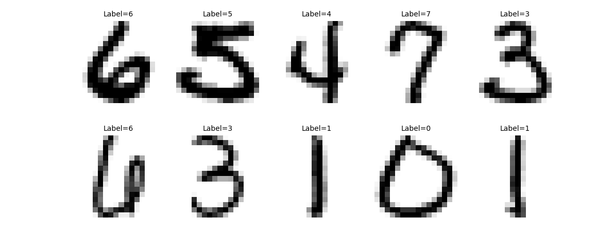
USPS dataset
Training Samples: 7291
Training set 10 random images

Slide 4
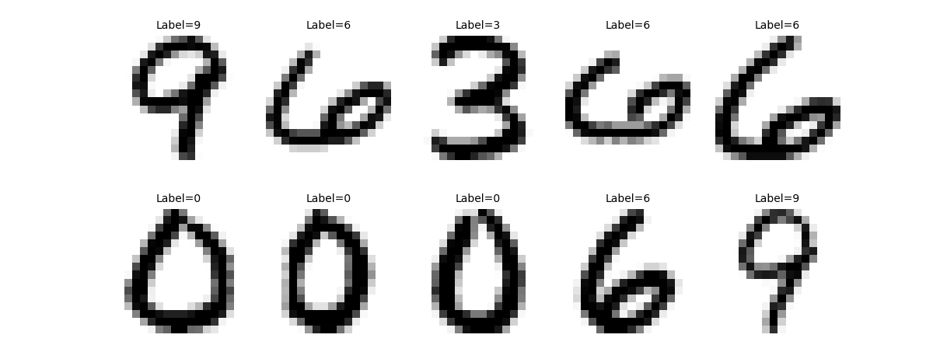
USPS dataset
Testing Samples: 2007
Testing set 10 random images

Slide 5
USPS dataset
Number of samples per digit
 | 0 | 1 | 2 | 3 | 4 | 5 | 6 | 7 | 8 | 9 | Total
Train | 1194 | 1005 | 731 | 658 | 652 | 556 | 664 | 645 | 542 | 644 | 7291
Test | 359 | 264 | 198 | 166 | 200 | 160 | 170 | 147 | 166 | 177 | 2007

Slide 6
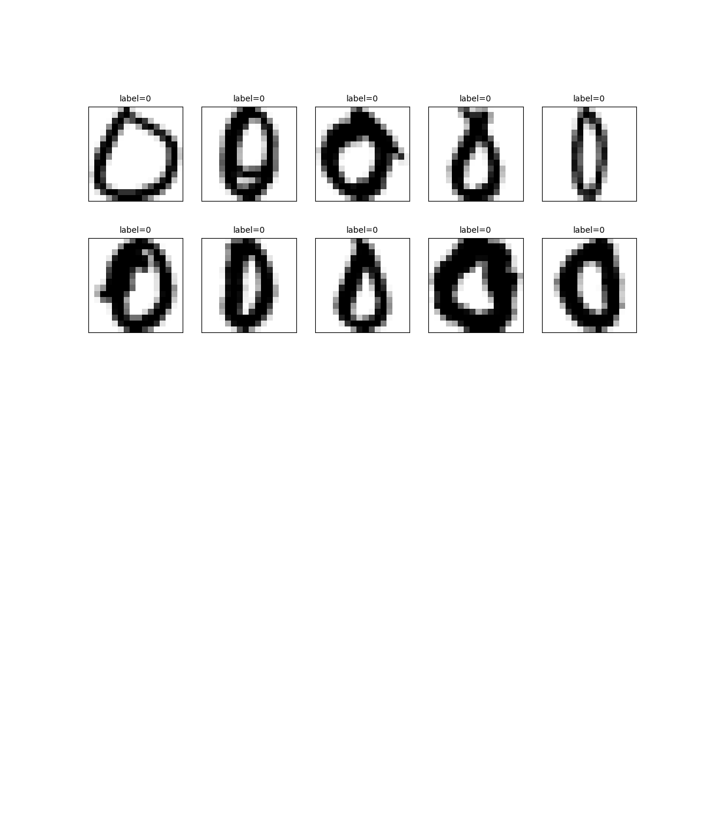
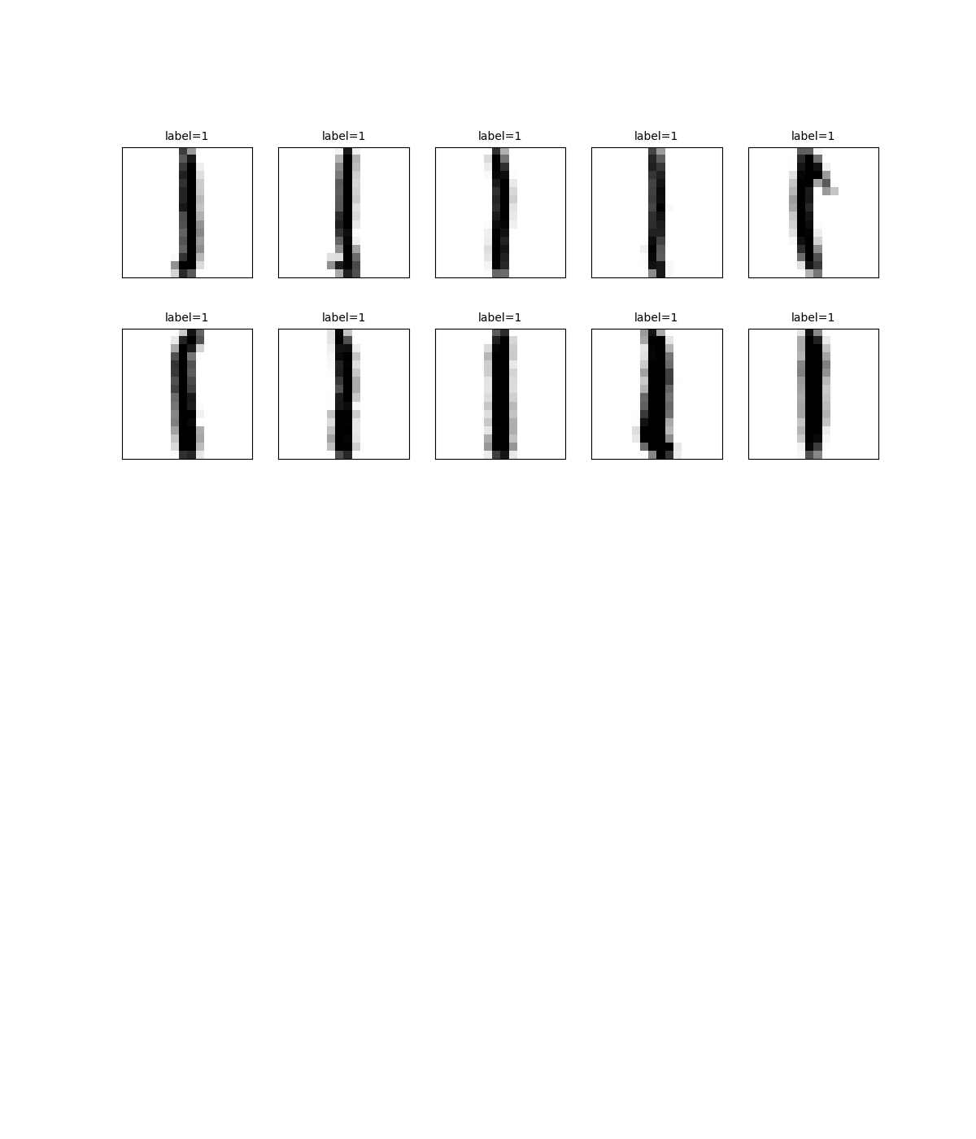
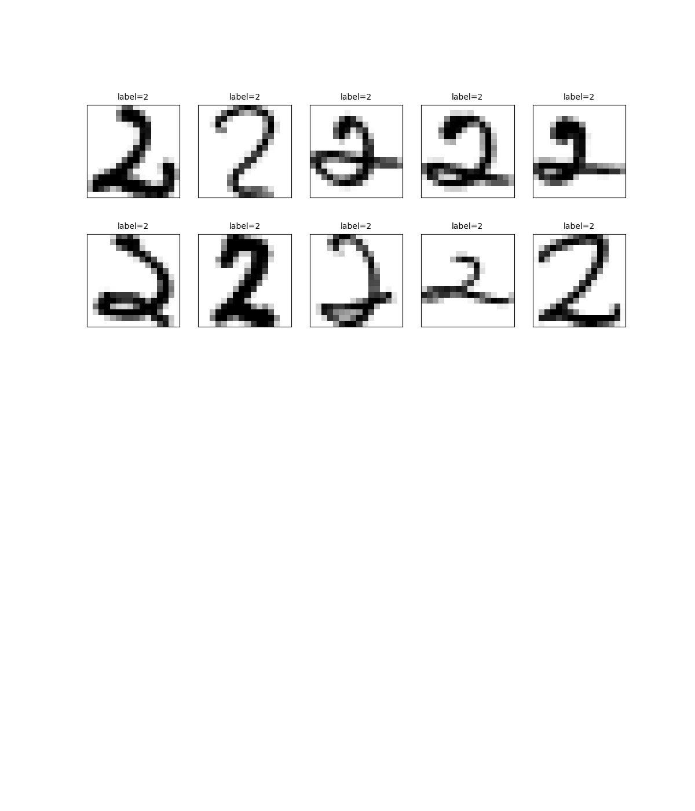
USPS dataset
Sample images by digit class from train set (0–2)

Slide 7
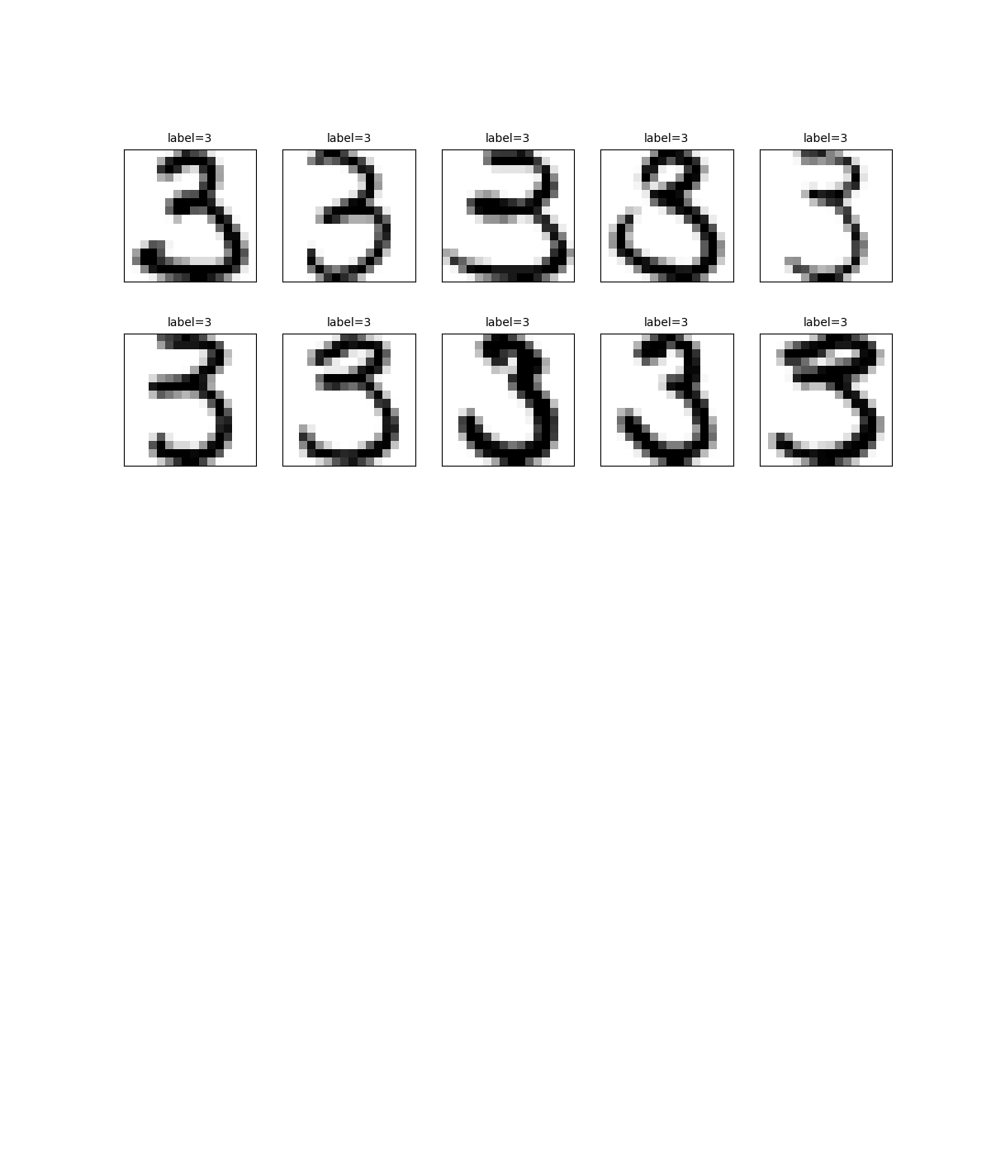
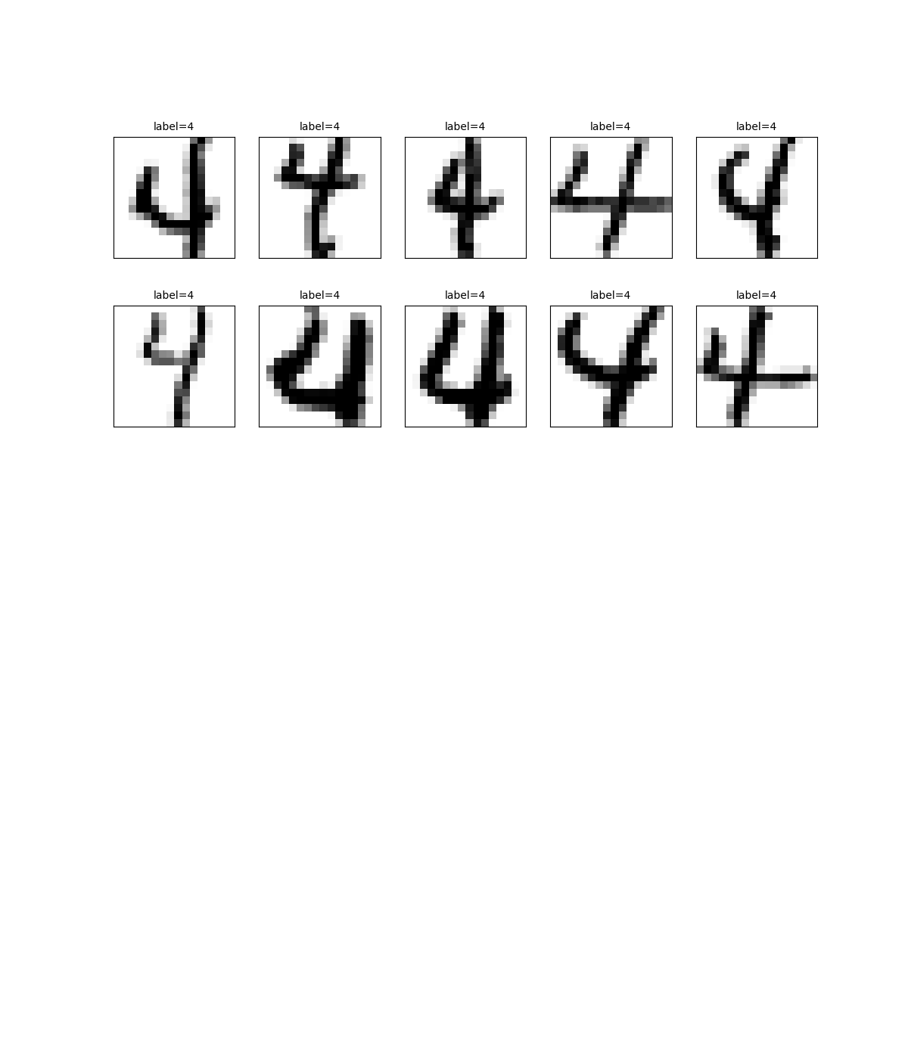
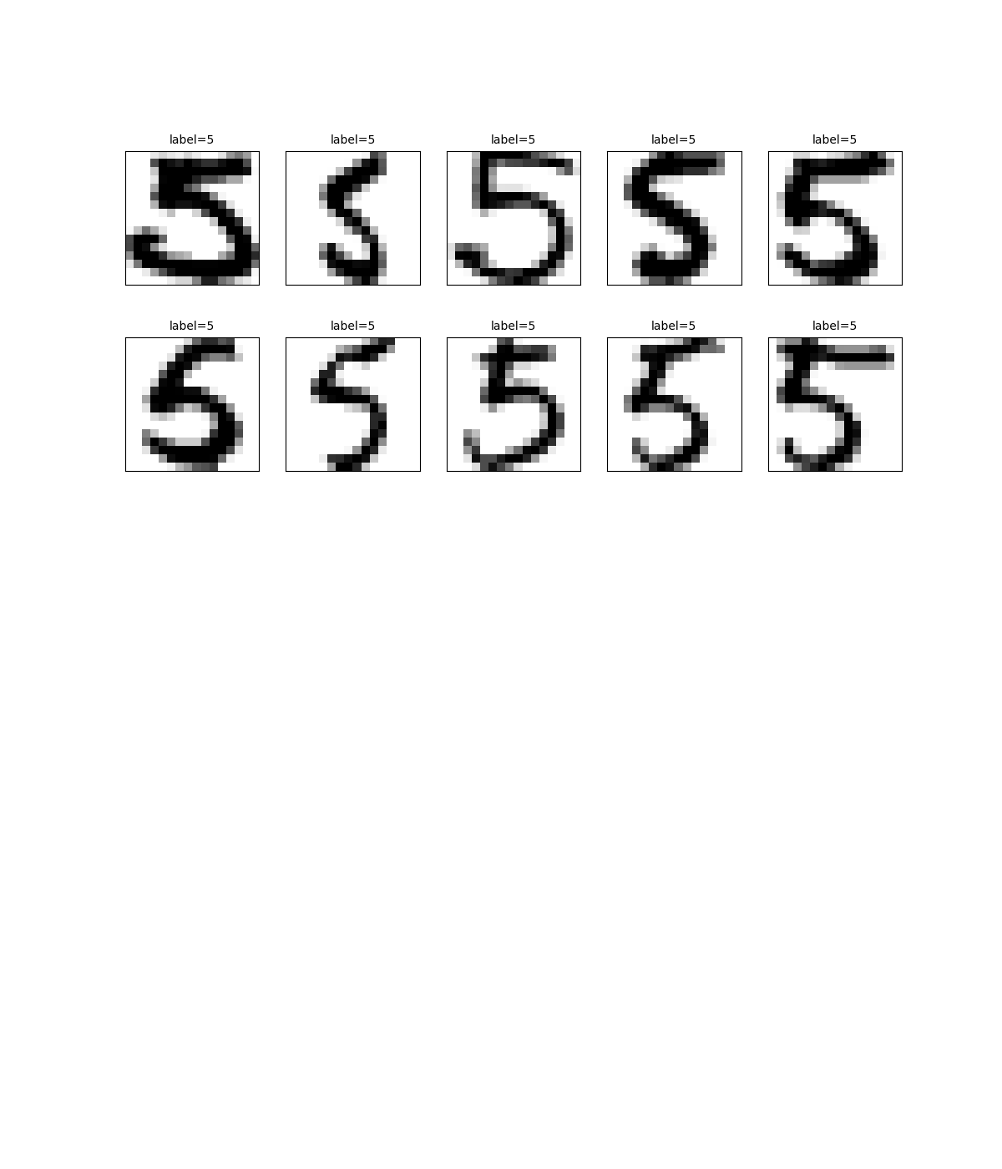
USPS dataset
Sample images by digit class from train set (3–5)

Slide 8
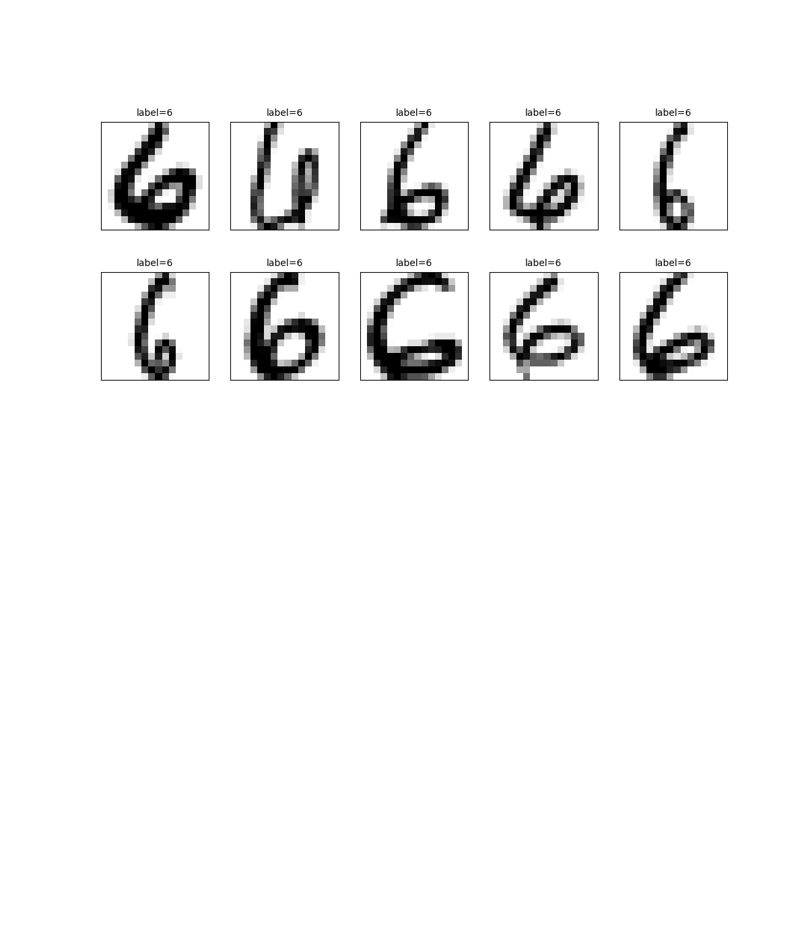
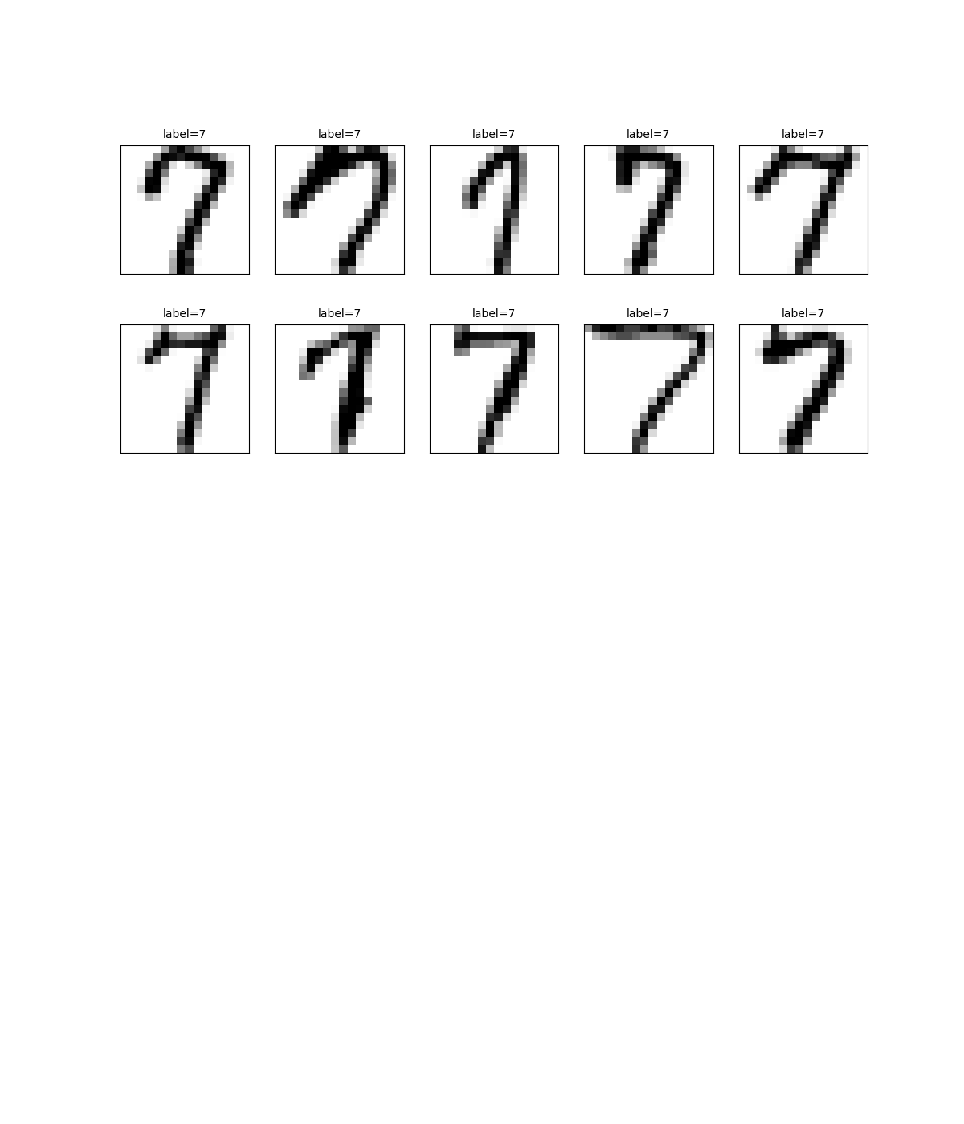
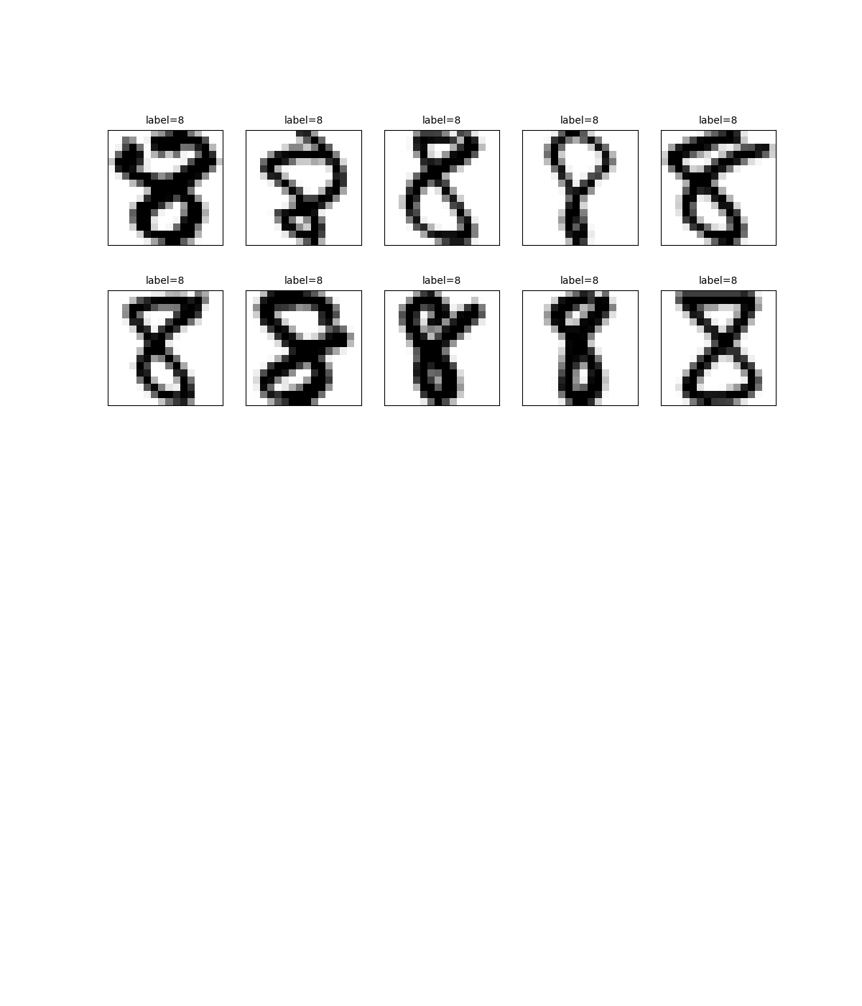
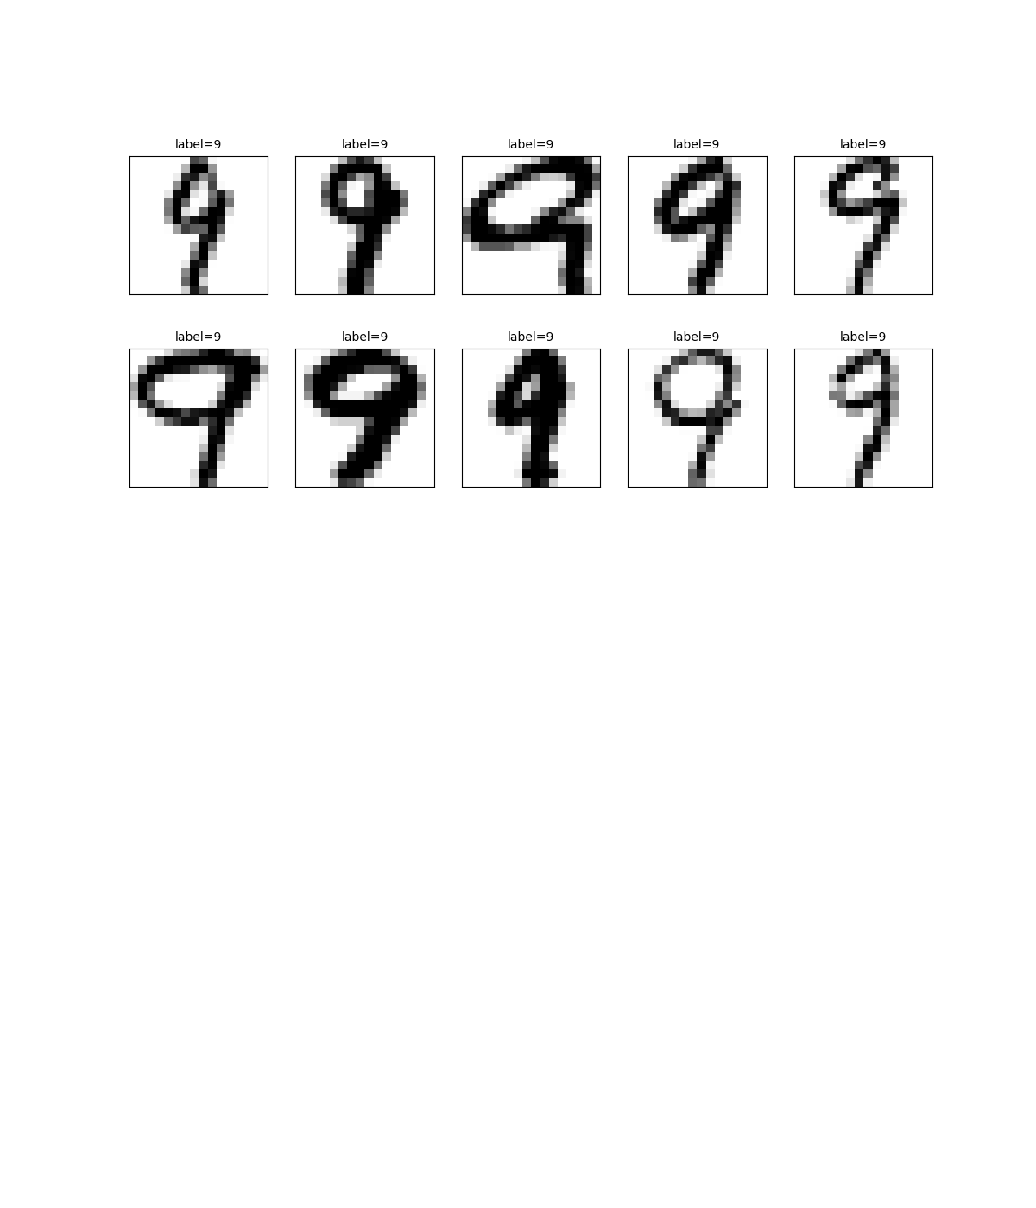
USPS dataset
Sample images by digit class from train set (6–9)

Slide 9
Student handwritten dataset
Images by digit from student handwritten

Slide 10
Taipower industrial artifacts – Japanese colonial period
Images by digit from Taipower industrial artifacts

Slide 11
Simple mean comparison

Slide 12
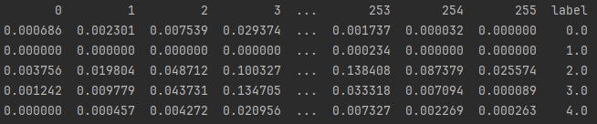
Simple mean comparison
Compute average images for digits 0–9 from the training set

Slide 13
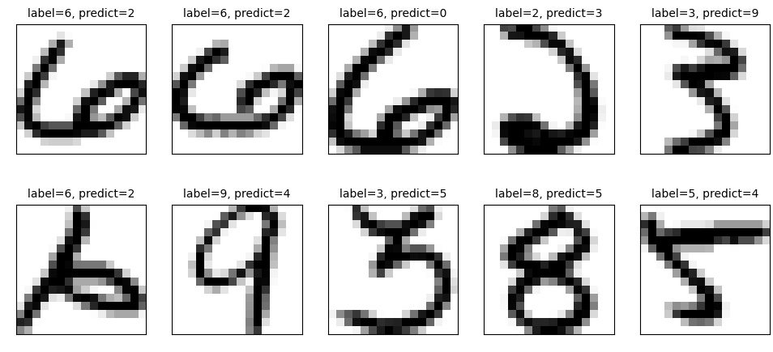
Simple mean comparison
Accuracy: 0.7768 (1559/2007 | 448 misclassified samples), Runtime: 2.13s
Top 10 misclassified samples

Slide 14
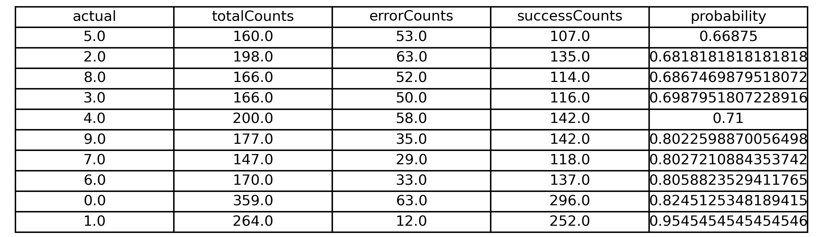
Simple mean comparison
Per-digit accuracy for digits 0 to 9

Slide 15
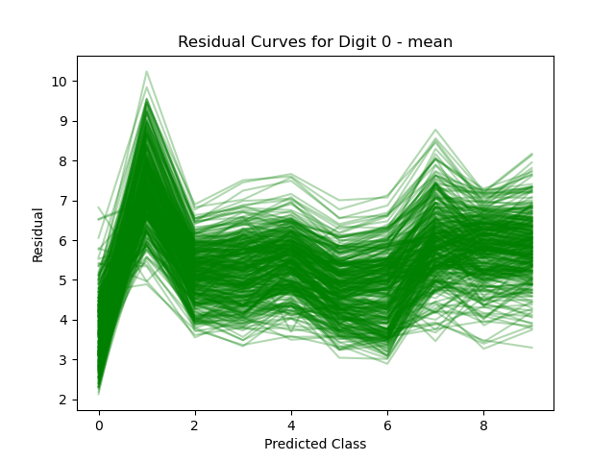
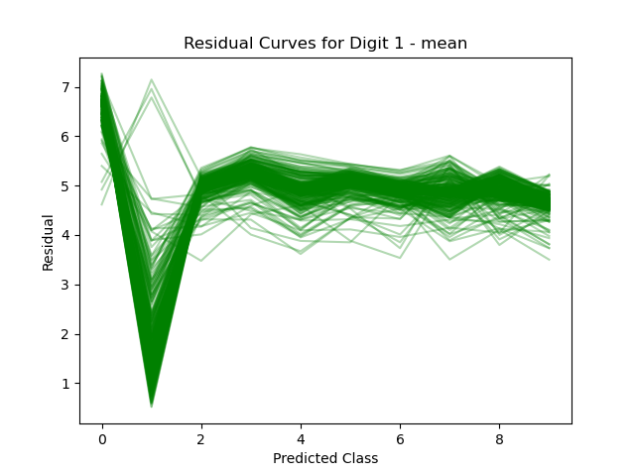
Simple mean comparison
Residual curves for digits with high classification accuracy

Slide 16
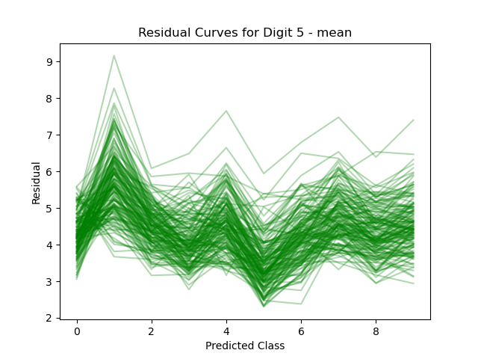
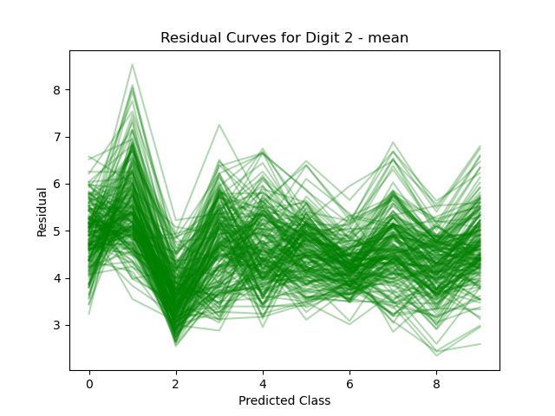
Simple mean comparison
Residual curves for digits with low classification accuracy

Slide 17
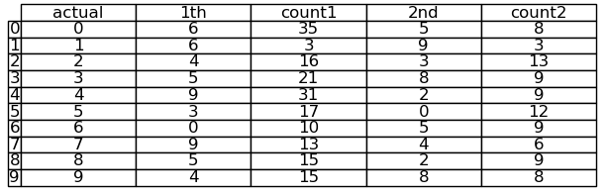
Simple mean comparison
Top 2 misclassified digits for each actual class

Slide 18
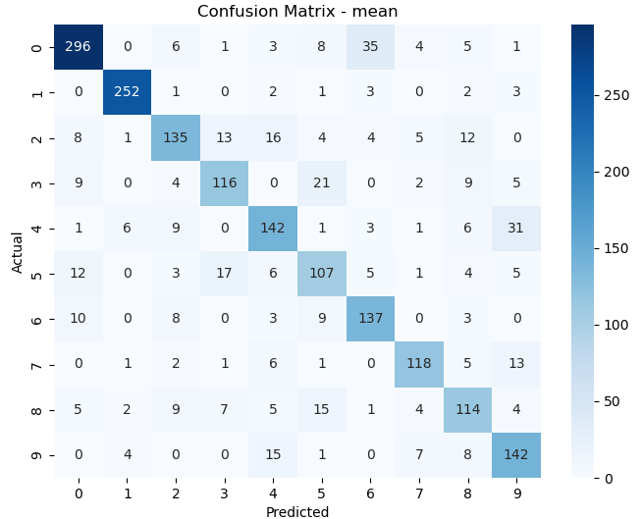
Simple mean comparison
Confusion matrix – simple mean method on USPS test set

Slide 19
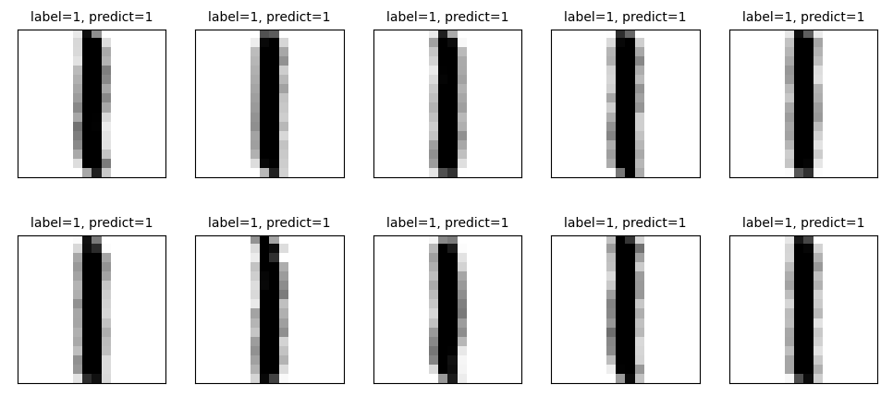
Simple mean comparison
Top 10 accurate predictions

Slide 20
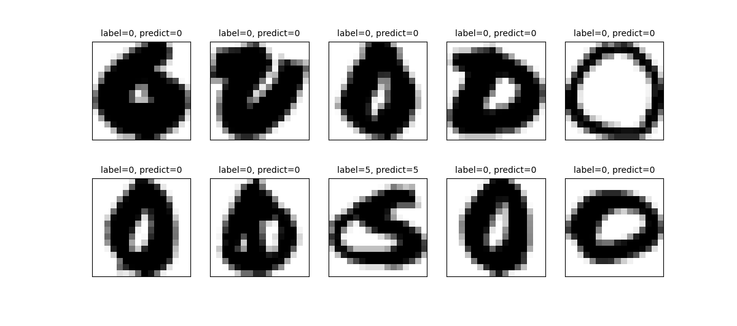
Simple mean comparison
Top 10 least accurate predictions

Slide 21
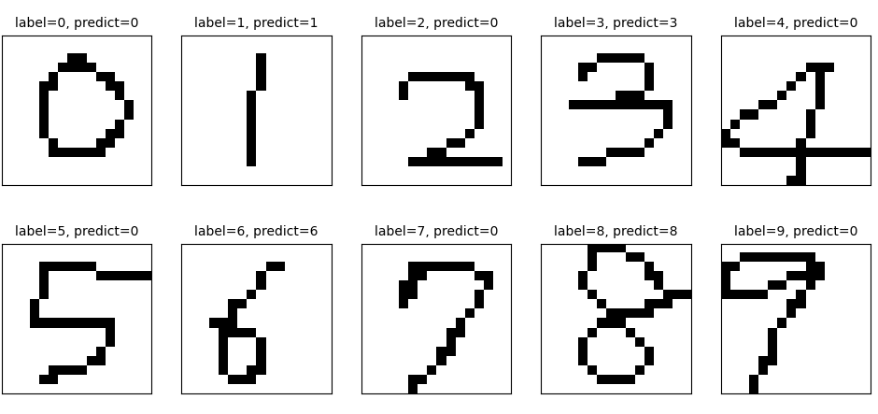
Simple mean comparison
Accuracy: 0.5 (5/10 | 5 misclassified samples)
Recognition of student handwritten digits (0–9)

Slide 22
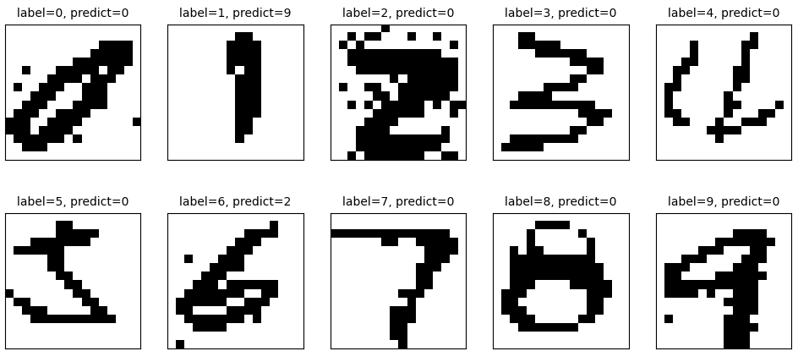
Simple mean comparison
Accuracy: 0.1 (1/10 | 9 misclassified samples)
Recognition of handwritten digits (0–9) from Taipower industrial artifacts – Japanese colonial period

Slide 23
SVD classification

Slide 24
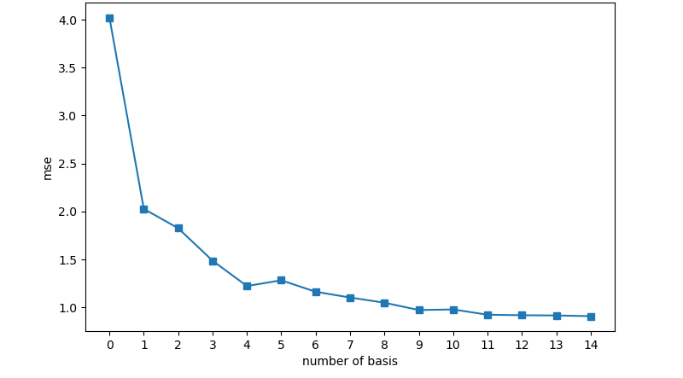
SVD classification
SVD (K = 15); Accuracy: 0.9442 (1895/2007 | 112 misclassified samples), Runtime: 6.49s
MSE vs. number of basis in SVD classification

Slide 25
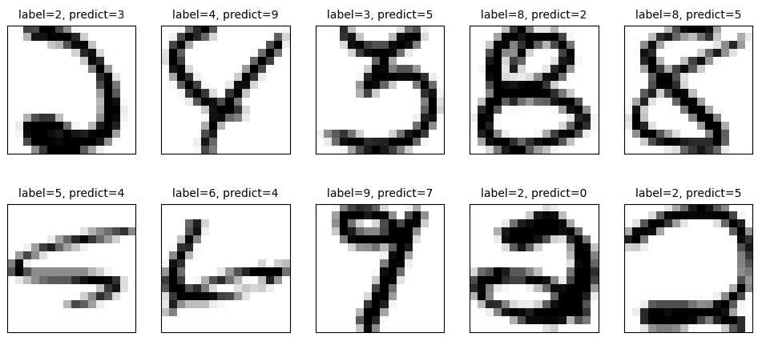
SVD classification
Top 10 misclassified samples

Slide 26
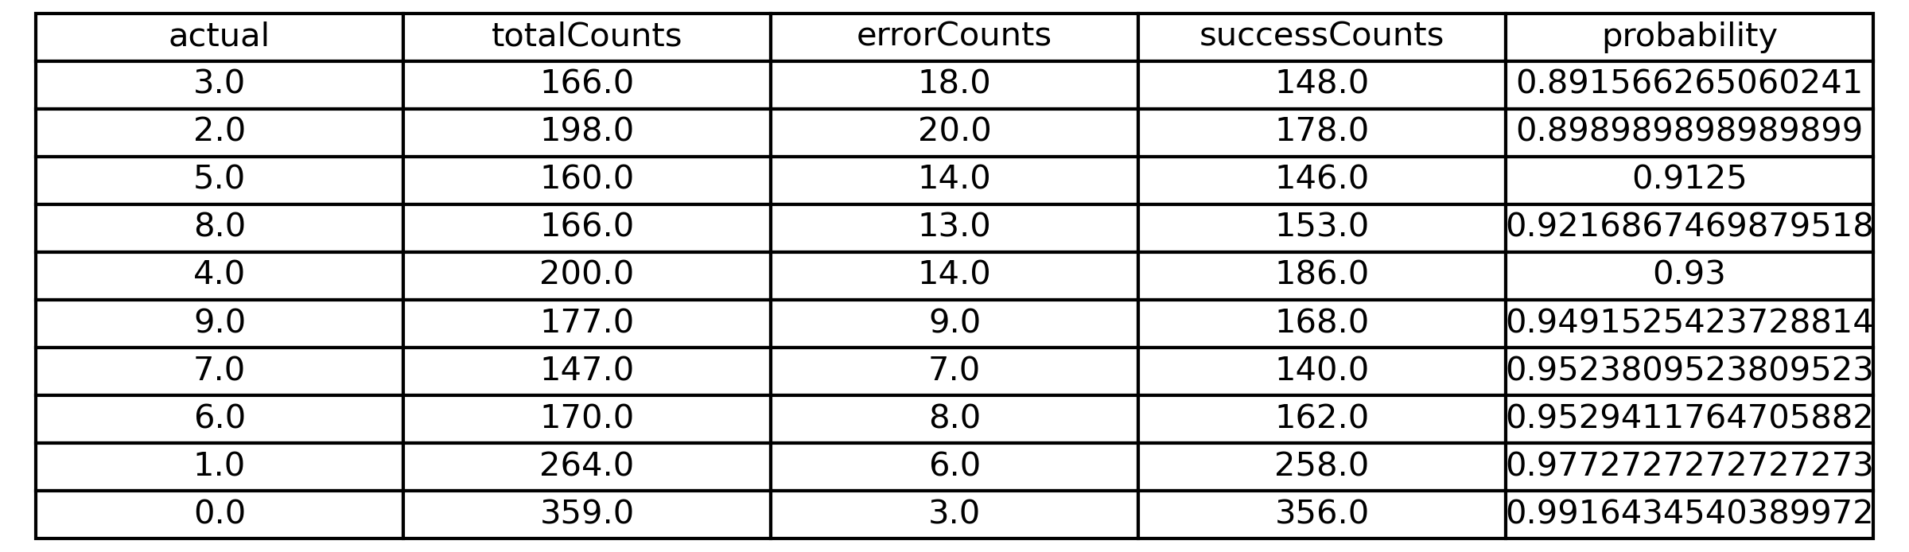
SVD classification
Per-digit accuracy for digits 0 to 9

Slide 27
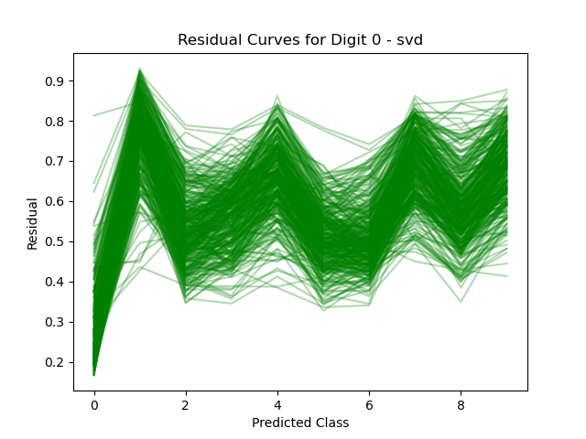
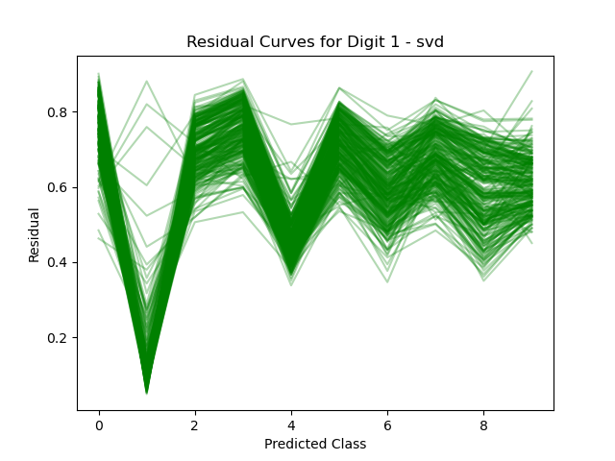
SVD classification
Residual curves for digits with high classification accuracy

Slide 28
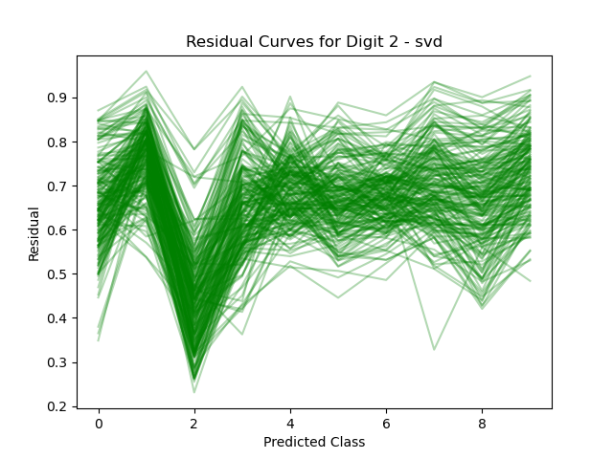
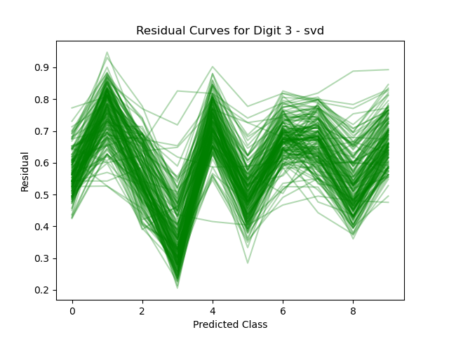
SVD classification
Residual curves for digits with low classification accuracy

Slide 29
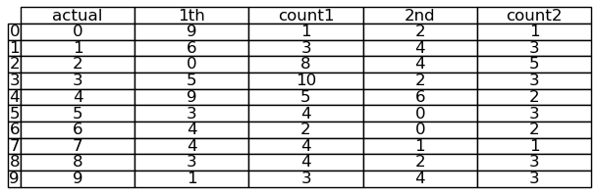
SVD classification
Top 2 misclassified digits for each actual class

Slide 30
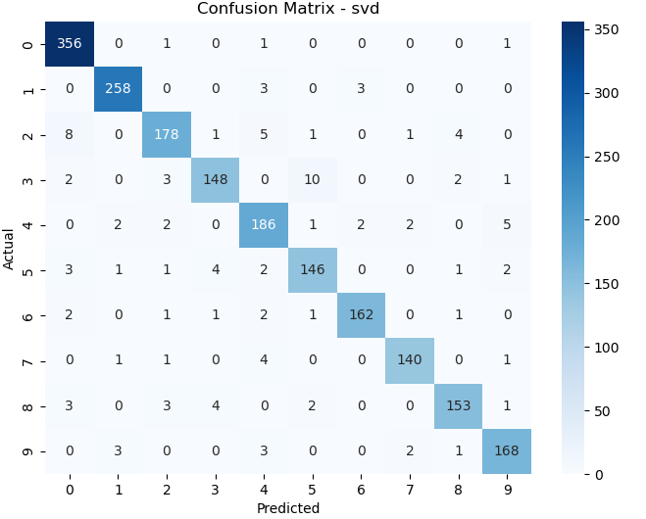
SVD classification
Confusion matrix – SVD classification method on USPS test set

Slide 31
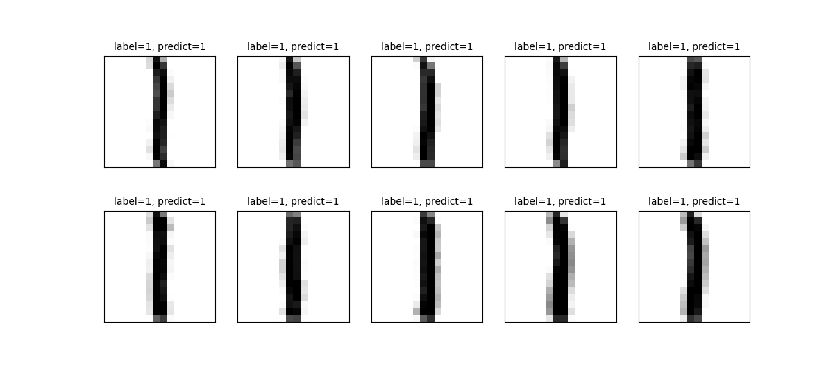
SVD classification
Top 10 accurate predictions

Slide 32
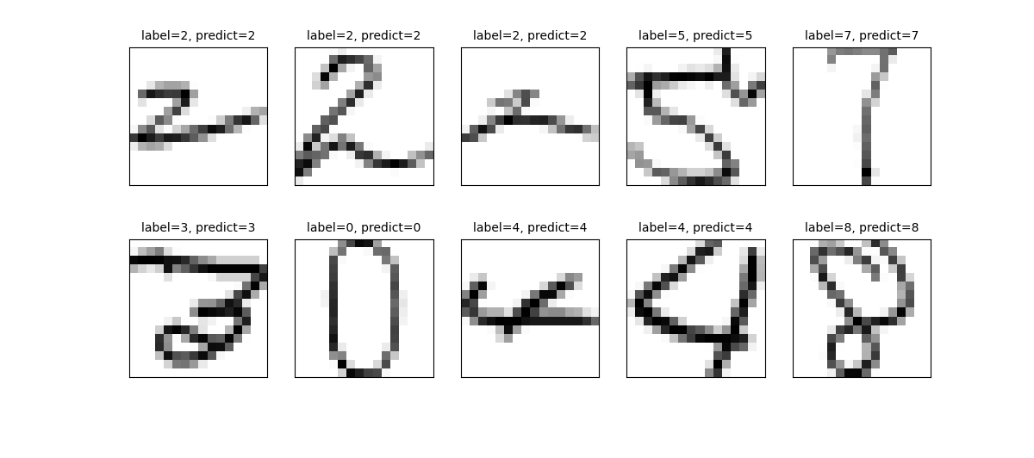
SVD classification
Top 10 least accurate predictions

Slide 33

SVD classification
Accuracy: 0.6 (6/10 | 4 misclassified samples)
Recognition of student handwritten digits (0–9)

Slide 34

SVD classification
Accuracy: 0.6 (6/10 | 4 misclassified samples)
Recognition of handwritten digits (0–9) from Taipower industrial artifacts – Japanese colonial period

Slide 35
HOSVD classification

Slide 36

HOSVD classification
SVD (K = 15); Accuracy: 0.9442 (1895/2007 | 112 misclassified samples), Runtime: 77.39s
MSE vs. number of basis in HOSVD classification

Slide 37

HOSVD classification
Top 10 misclassified samples

Slide 38
HOSVD classification
Per-digit accuracy for digits 0 to 9

Slide 39
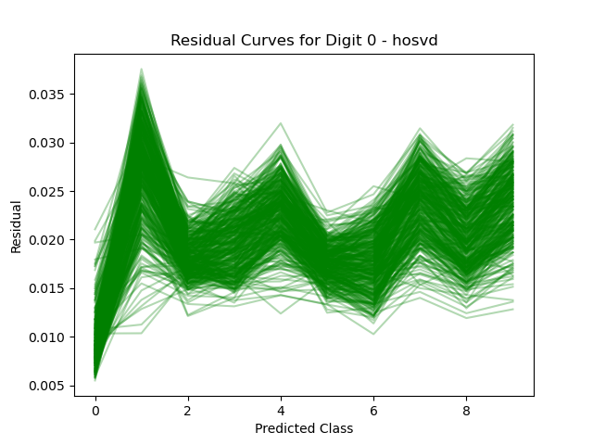
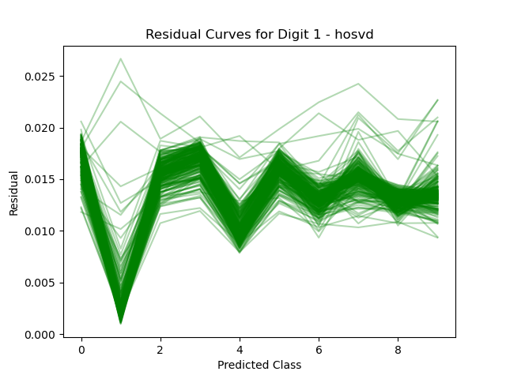
HOSVD classification
Residual curves for digits with high classification accuracy

Slide 40
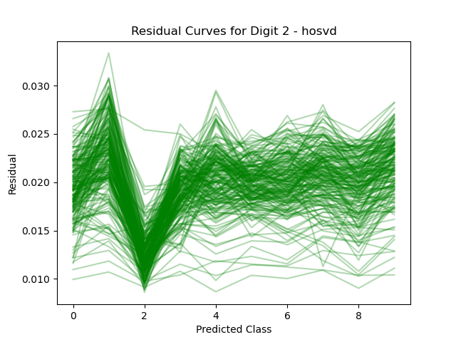
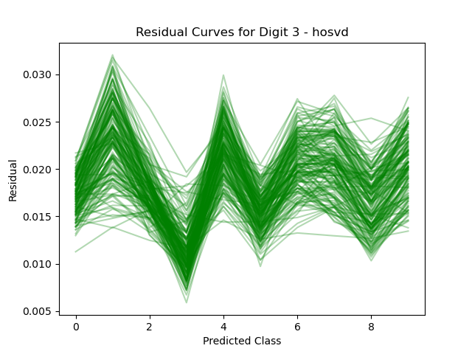
HOSVD classification
Residual curves for digits with low classification accuracy

Slide 41
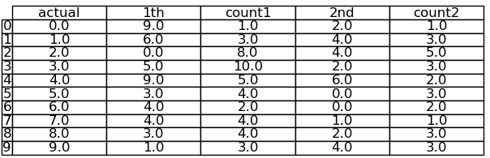
HOSVD classification
Top 2 misclassified digits for each actual class

Slide 42

HOSVD classification
Confusion matrix – HOSVD classification method on USPS test set

Slide 43
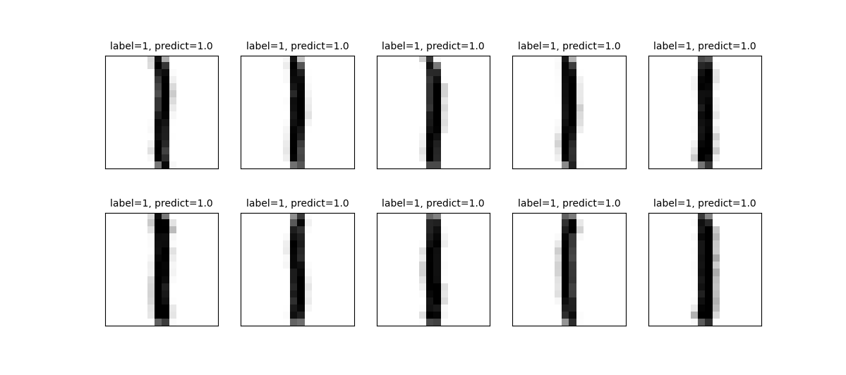
HOSVD classification
Top 10 accurate predictions

Slide 44
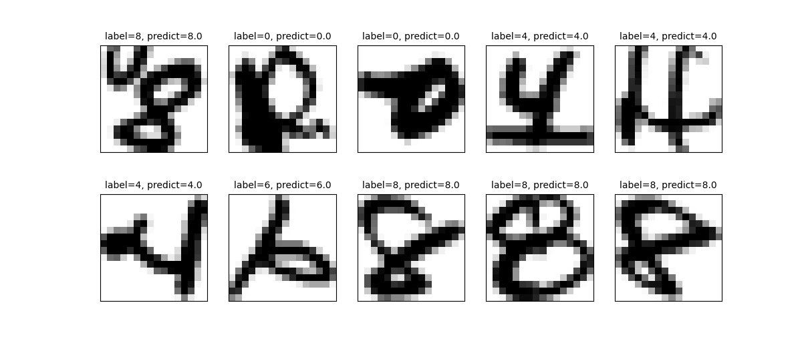
HOSVD classification
Top 10 least accurate predictions

Slide 45

HOSVD classification
Accuracy: 0.6 (6/10 | 4 misclassified samples)
Recognition of student handwritten digits (0–9)

Slide 46

HOSVD classification
Accuracy: 0.6 (6/10 | 4 misclassified samples)
Recognition of handwritten digits (0–9) from Taipower industrial artifacts – Japanese colonial period

Slide 47
Random forest

Slide 48
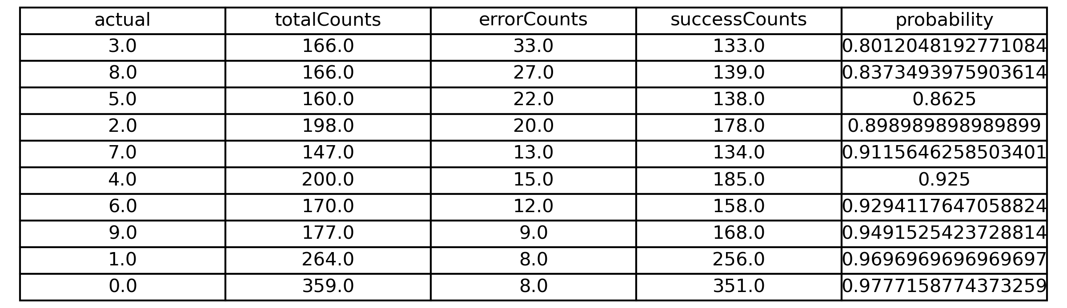
Random forest
Accuracy: 0.9168 (1840/2007 | 167 misclassified samples), Runtime: 0.34s
Per-digit accuracy for digits 0 to 9

Slide 49

Random forest
Top 2 misclassified digits for each actual class

Slide 50
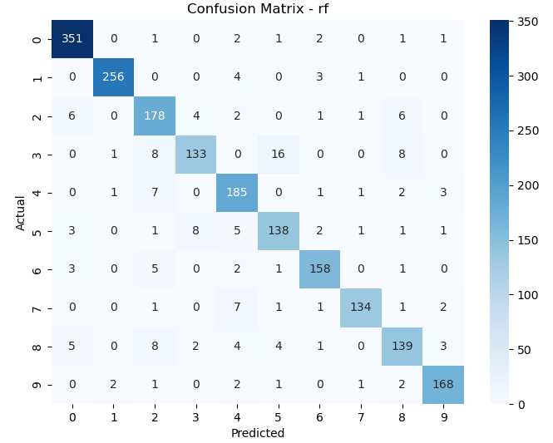
Random forest
Confusion matrix – Random forest method on USPS test set

Slide 51

Random forest
Accuracy: 0.2 (2/10 | 8 misclassified samples)
Recognition of student handwritten digits (0–9)

Slide 52

Random forest
Accuracy: 0.5 (5/10 | 5 misclassified samples)
Recognition of handwritten digits (0–9) from Taipower industrial artifacts – Japanese colonial period

Slide 53
Multilayer perceptron

Slide 54
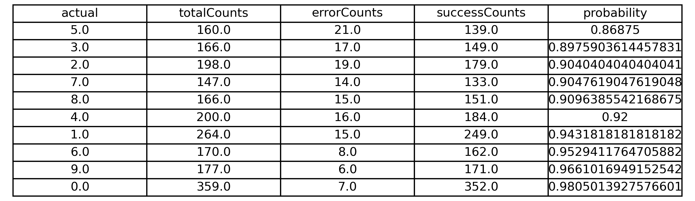
Multilayer perceptron
Accuracy: 0.9312 (1869/2007 | 138 misclassified samples), Runtime: 7.57s
Per-digit accuracy for digits 0 to 9

Slide 55

Multilayer perceptron
Top 2 misclassified digits for each actual class

Slide 56
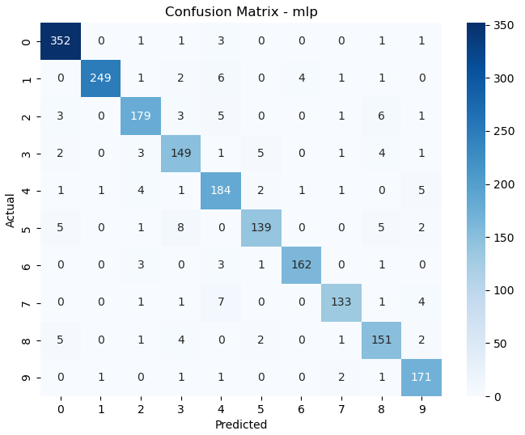
Multilayer perceptron
Confusion matrix – Multilayer perceptron method on USPS test set

Slide 57

Multilayer perceptron
Accuracy: 0.6 (6/10 | 4 misclassified samples)
Recognition of student handwritten digits (0–9)

Slide 58

Multilayer perceptron
Accuracy: 0.2 (2/10 | 8 misclassified samples)
Recognition of handwritten digits (0–9) from Taipower industrial artifacts – Japanese colonial period

Slide 59
CNN

Slide 60
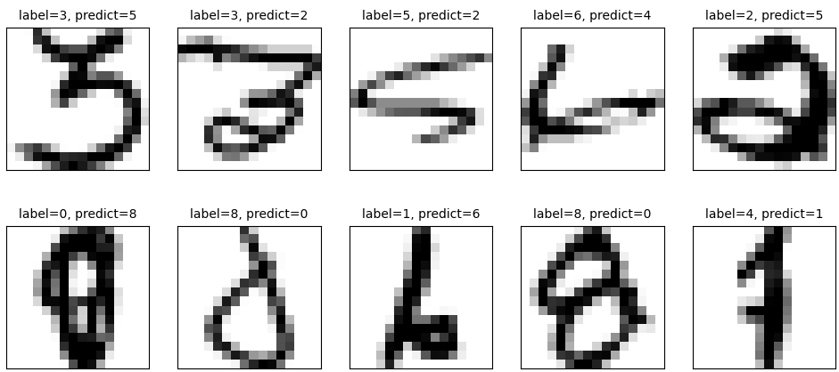
CNN
Accuracy: 0.9571 (1921/2007 | 86 misclassified samples), Runtime: 8.11s
Top 10 misclassified samples

Slide 61
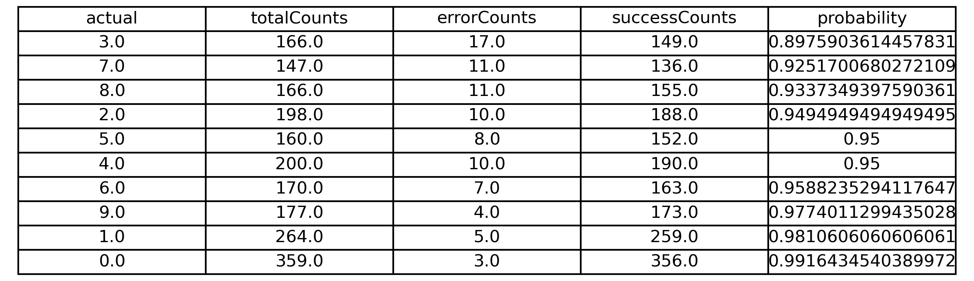
CNN
Per-digit accuracy for digits 0 to 9

Slide 62

CNN
Top 2 misclassified digits for each actual class

Slide 63
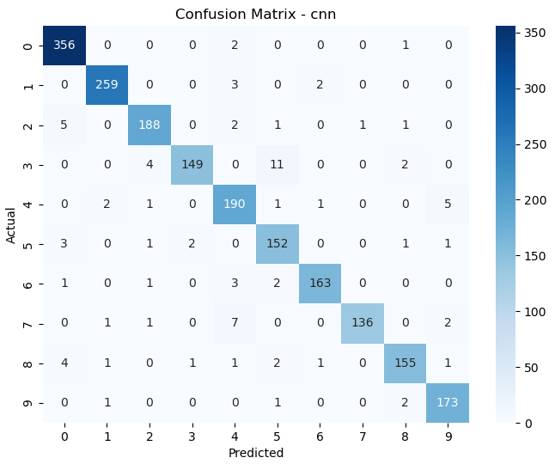
CNN
Confusion matrix – CNN method on USPS test set

Slide 64

CNN
Accuracy: 0.8 (8/10 | 2 misclassified samples)
Recognition of student handwritten digits (0–9)

Slide 65

CNN
Accuracy: 0.4 (4/10 | 6 misclassified samples)
Recognition of handwritten digits (0–9) from Taipower industrial artifacts – Japanese colonial period

Slide 66
RNN

Slide 67

RNN
Accuracy: 0.9342 (1875/2007 | 132 misclassified samples), Runtime: 25.04s
Per-digit accuracy for digits 0 to 9

Slide 68

RNN
Top 2 misclassified digits for each actual class

Slide 69

RNN
Confusion matrix – RNN method on USPS test set

Slide 70

RNN
Accuracy: 0.2 (2/10 | 8 misclassified samples)
Recognition of student handwritten digits (0–9)

Slide 71

RNN
Accuracy: 0.1 (1/10 | 9 misclassified samples)
Recognition of handwritten digits (0–9) from Taipower industrial artifacts – Japanese colonial period

Slide 72
LSTM

Slide 73

LSTM
Accuracy: 0.9357 (1878/2007 | 129 misclassified samples), Runtime: 26.77s
Per-digit accuracy for digits 0 to 9

Slide 74

LSTM
Top 2 misclassified digits for each actual class

Slide 75

LSTM
Confusion matrix – LSTM method on USPS test set

Slide 76

LSTM
Accuracy: 0.2 (2/10 | 8 misclassified samples)
Recognition of student handwritten digits (0–9)

Slide 77

LSTM
Accuracy: 0.1 (1/10 | 9 misclassified samples)
Recognition of handwritten digits (0–9) from Taipower industrial artifacts – Japanese colonial period

Slide 78

Summary
Model accuracy on USPS test set and external handwriting datasets

Slide 79



Code

